Slide 1
V.L.ANISH
Generative AI for Engineering (E2324)
IBM-EDUNET FOUNDATION
Email: anishlogan6@gmail.com
Reg No: 211521243012
Department of AI & DS
Panimalar Institute of Technology, Chennai
1/4/2024

Slide 2
PROJECT TITLE
BIRDS IMAGE GENERATION USING GENERATIVE AI

Slide 3

AGENDA
Problem Statement
Proposed System/Solution
System Development Approach
Algorithm & Deployment
Result
Conclusion
Future Scope
References

Slide 4
PROBLEM STATEMENT
Generating realistic images of birds using generative AI presents challenges in dataset collection, model architecture design, training with limited data, ensuring diversity, evaluation metrics, optimization, interactive generation, and deployment. Addressing these challenges involves collecting diverse bird datasets, designing effective generative models, handling limited data, ensuring realism and diversity, developing evaluation metrics, fine-tuning models, enabling interactive generation, and deploying the system for various applications. This project aims to overcome these challenges to create a high-quality and diverse bird image generation system with potential applications in wildlife conservation, education, and art.

Slide 5
PROPOSED SYSTEM
Our proposed system aims to advance bird image generation by enhancing data acquisition, employing advanced model architectures like DCGANs or StyleGANs, and implementing improved training strategies to stabilize training and prevent mode collapse. Integration of semantic understanding and attention mechanisms will further refine image generation, while unsupervised representation learning techniques will facilitate better control over generated images. Diversity promotion methods will ensure a wide range of bird species, poses, and backgrounds. User interaction features will allow for iterative refinement based on user feedback, while ethical considerations and bias mitigation strategies will be incorporated to address potential biases and ethical implications. Deployment will involve the creation of an online platform or application for bird image generation, with rigorous evaluation metrics and user studies to assess image quality, diversity, and realism.
‹#›

Slide 6
SYSTEM DEVELOPMENT APPROACH
The proposed system provided uses several technologies and libraries for data processing, deep learning, and visualization. Here's a list of the key technologies used:
Python: The programming language used for the entire codebase.
Pandas: Library for data manipulation and analysis.
NumPy: Library for numerical operations.
Scikit-learn: Library for machine learning tasks, used here for data preprocessing and evaluation metrics calculation.
TensorFlow: Deep learning framework used to build and train the LSTM model.
Plotly: Library for interactive data visualization.

Slide 7
ALGORITHM & DEVELOPMENT
1. Data Loading And Preprocessing:
- Load the dataset of bird images using torchvision ImageFolder, and preprocess the images to ensure uniformity in size and format.
2. Model Initialization:
- Initialize the discriminator and generator neural network models using PyTorch's nn.Sequential, with appropriate architectures for discriminating between real and fake images, and generating realistic bird images.
3. Training Setup:
- Define functions for training the discriminator and generator networks separately, incorporating optimization and loss calculation steps.
4. Training Loop:
- Implement a training loop that alternately trains the discriminator and generator networks, optimizing their parameters to improve image generation quality and discriminator performance.

Slide 8
ALGORITHM & DEVELOPMENT
5. Training Results Logging:
- Record and log losses and scores for the discriminator and generator during training to monitor training progress and performance.
6. Model Saving:
- Save the trained discriminator and generator models' state dictionaries to files for future use and deployment.
7. Generated Image Display:
- Optionally, display generated images at specific intervals during training to visualize the progress and quality of generated images.
8. Hyperparameter Tuning:
- Experiment with different hyperparameters such as learning rates, batch sizes, and model architectures to optimize training stability and image generation quality.

Slide 9
ALGORITHM & DEVELOPMENT
9. Validation and Evaluation:
- Evaluate the trained models using validation datasets and evaluation metrics to assess image generation quality, diversity, and realism objectively.
10. Iterative Refinement:
- Based on validation results and user feedback, refine the model architecture, training strategy, and hyperparameters iteratively to improve image generation performance.
11. Deployment and Integration:
- Deploy the trained model as part of an online platform or application for bird image generation, ensuring scalability, reliability, and user privacy considerations.
12. Documentation and Maintenance:
- Document the development process, including algorithmic details, implementation steps, and deployment procedures, and establish a maintenance plan for ongoing updates and improvements.

Slide 10
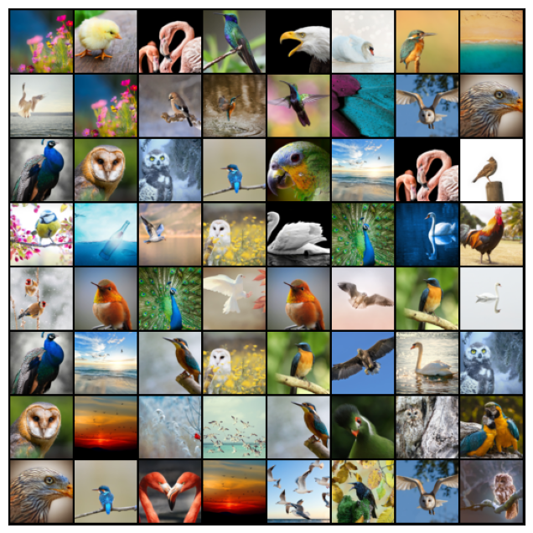
RESULT
‹#›

Slide 11
CONCLUSION
In conclusion, the development of a bird image generation system using Generative Adversarial Networks (GANs) offers promising opportunities for creating high-quality and diverse bird images with applications across various domains. Through the systematic implementation of advanced model architectures, training strategies, and evaluation techniques, we can overcome challenges in generating realistic and contextually relevant bird images. By leveraging interactive features, user feedback mechanisms, and ethical considerations, we ensure responsible deployment and user satisfaction. As we continue to innovate and refine our system, we contribute to the advancement of generative AI and its potential to revolutionize wildlife conservation, education, digital art, and more. With continued research and development, the future holds exciting prospects for bird image generation, empowering us to explore and appreciate the beauty of avian life in new and immersive ways.
The Coding of the project is uploaded in GitHub, click below button to see the code :)
Code Link
‹#›

Slide 12
FUTURE SCOPE
1. enhanced realism and diversity.
2. improved interactivity and control.
3. semantic understanding and contextual generation.
4. cross-domain applications.
5. integration with ar and vr.
6. applications in conservation and research.
7. ethical considerations and bias mitigation.
8. collaborative and open-source development.
9. commercial applications and creative industries.
10. continued research and exploration.

Slide 13
REFERENCES
GitHub Link: Beyonderanish
Dataset Link: It’s a personally created experimental Dataset uploaded on kaggle

Slide 14
THANK YOU!

